Slide 1
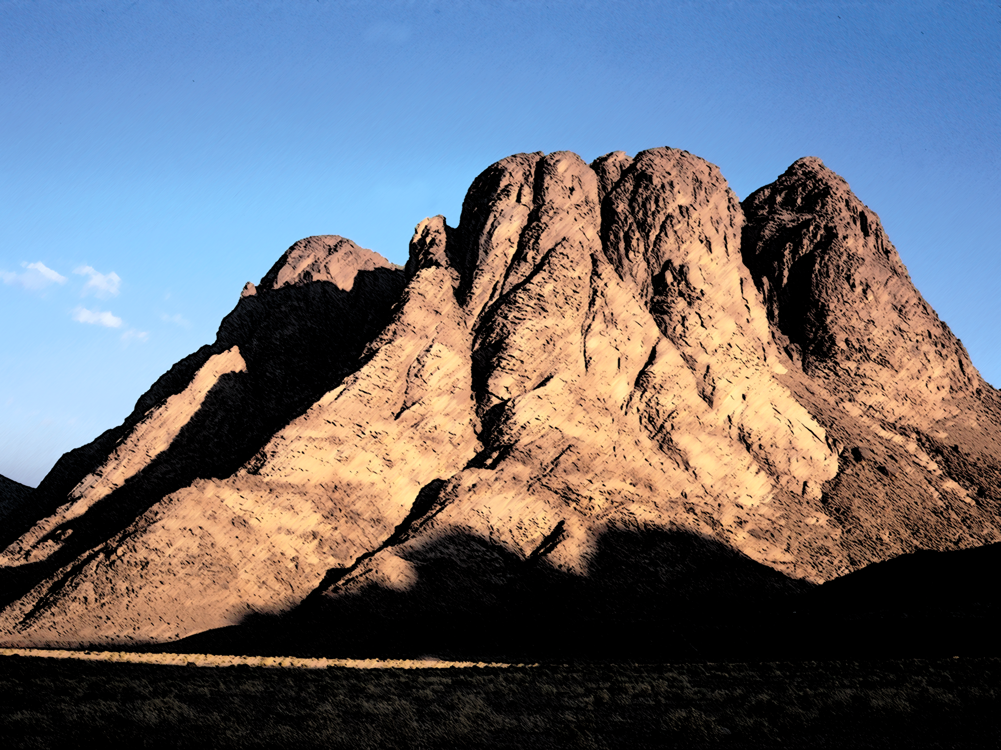
Preparing to Meet God!
Exodus 19

Slide 2
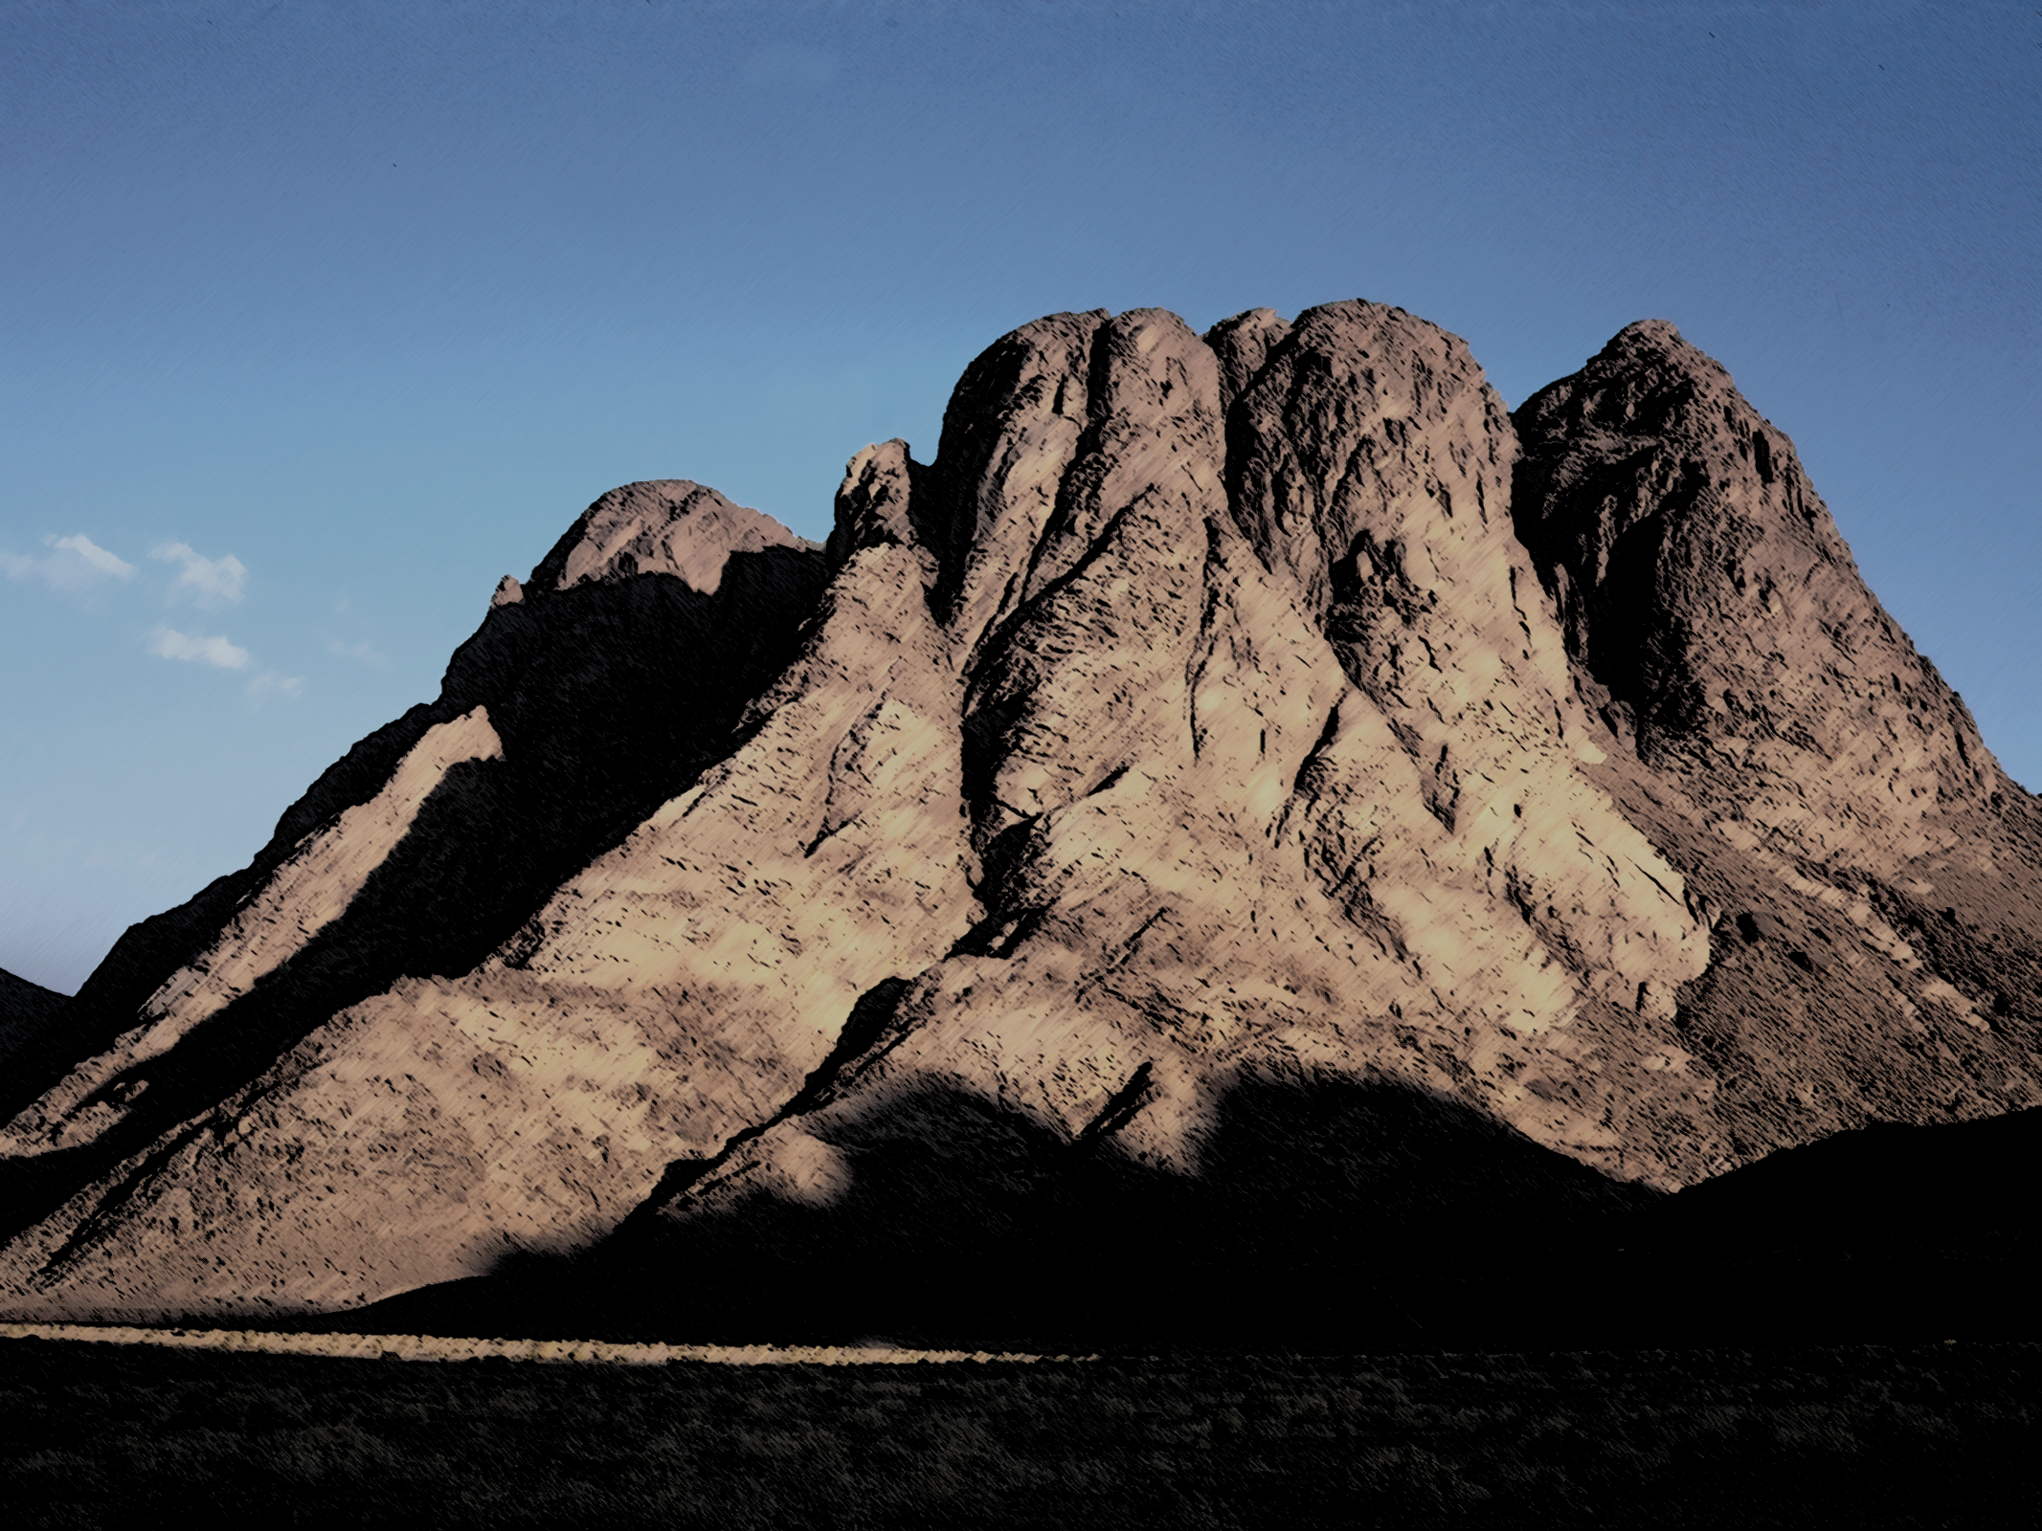
Preparing to Meet God!
Pro_9:10 The fear of the LORD is the beginning of wisdom: and the knowledge of the holy is understanding.
Job_28:28 And unto man he said, Behold, the fear of the Lord, that is wisdom; and to depart from evil is understanding.
Psa_19:9 The fear of the LORD is clean, enduring for ever: the judgments of the LORD are true and righteous altogether.
Pro_2:5 Then shalt thou understand the fear of the LORD, and find the knowledge of God.
Pro_14:26 In the fear of the LORD is strong confidence: and his children shall have a place of refuge.
Psa 147:11 The LORD taketh pleasure in them that fear him, in those that hope in his mercy.

Slide 3
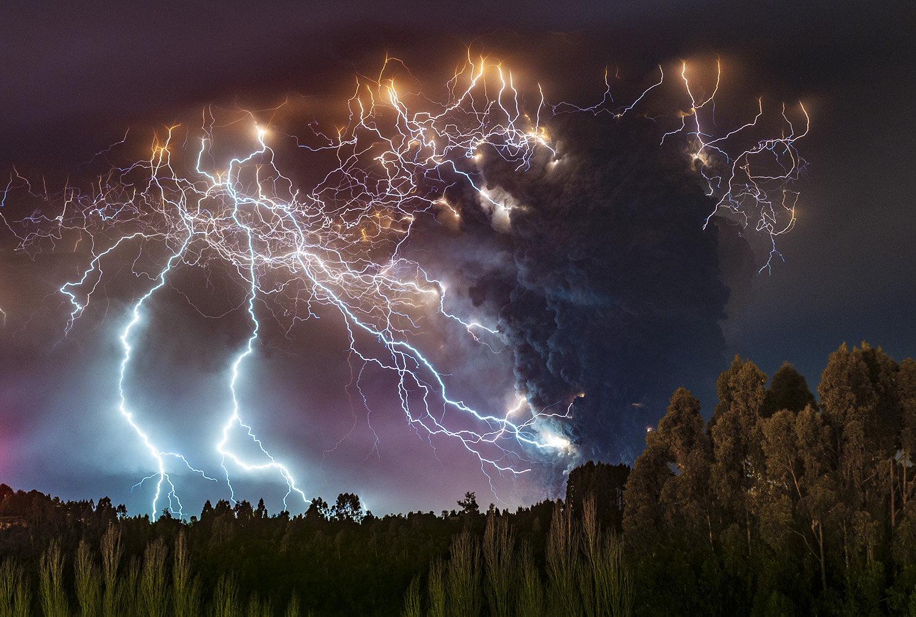

Slide 4
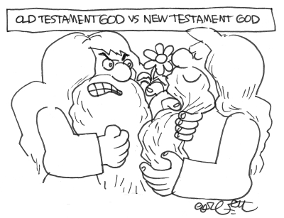
Preparing to Meet God!
Knowing Fear
Jesus fulfilled the law, but He did not disparage the law or lower God’s standards.
  Don’t kill, don’t commit adultery…..
He took the standard even higher
  Don’t hate, don’t lust….
Godly fear is directional, keeping you away from consequences, and pointing you toward blessings.

Slide 5
Preparing to Meet God!
Great Expectations
1. Consecration
2. Cleansing
3. Conformity

Slide 6
Preparing to Meet God!
Consecration
Sanctify
  To separate something out of another thing for a specific use or purpose
God’s specific use and purpose
  He seeks His people,
  He buys His people
  He brings them to Himself
    To be His treasure for his pleasure

Slide 7
Preparing to Meet God!
Consecration
Mal 3:17 And they shall be mine, saith the LORD of hosts, in that day when I make up my jewels (Treasure); and I will spare them, as a man spareth his own son that serveth him. 18 Then shall ye return, and discern between the righteous and the wicked, between him that serveth God and him that serveth him not.
1Pe 1:18 Forasmuch as ye know that ye were not redeemed with corruptible things, as silver and gold, from your vain conversation received by tradition from your fathers; 19 But with the precious blood of Christ, as of a lamb without blemish and without spot:

Slide 8
Preparing to Meet God!
Consecration
Sanctify
  To separate something out of another thing for a specific use or purpose
God’s specific use and purpose
  He sought Israel
  He bought Israel
  He brought them to Himself
    To be His treasure for his pleasure
    To be holy, His priests for His purpose of redeeming mankind

Slide 9
Preparing to Meet God!
Consecration
Lev 20:7 Sanctify yourselves therefore, and be ye holy: for I am the LORD your God.
Eph 1:4 According as he hath chosen us in him before the foundation of the world, that we should be holy and without blame before him in love:
1Pe 1:15 But as he which hath called you is holy, so be ye holy in all manner of conversation; 16 Because it is written, Be ye holy; for I am holy.

Slide 10
Preparing to Meet God!
Consecration
Commit to obey
  Always draw near
  Deal with all sin
Let God set the agenda
  Trust the Man of God
  Do not dictate God’s topic
Plan your sanctification
  We are sanctified to our Head
  It doesn’t happen accidentally

Slide 11
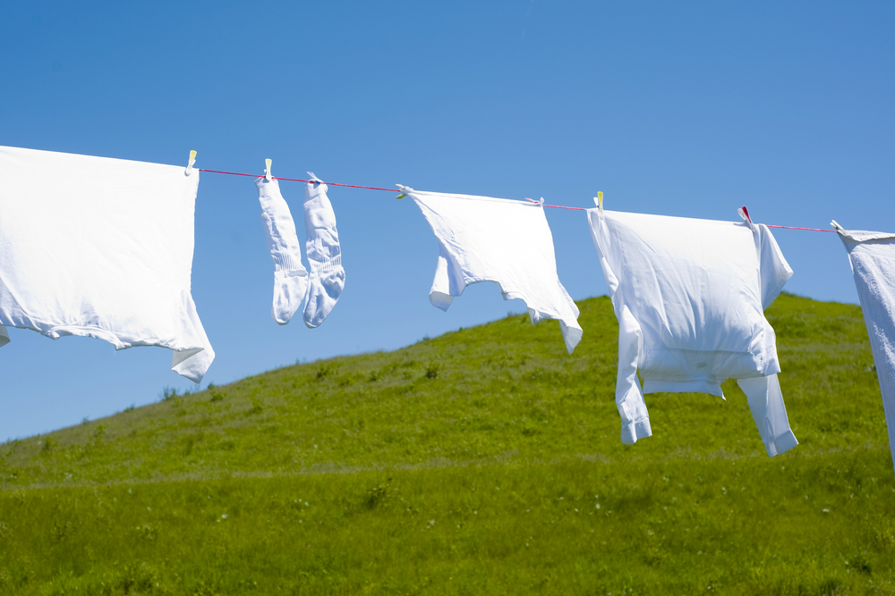
Preparing to Meet God!
Cleanliness
Physical
  Cleanliness communicates importance
  Cleanliness carries a cost
  Cleanliness is inviting
Spiritual
  Self Righteousness
    Dirt from the World
    Stain of the flesh

Slide 12
Preparing to Meet God!
Cleanliness
2Co 7:1 Having therefore these promises, dearly beloved, let us cleanse ourselves from all filthiness of the flesh and spirit, perfecting holiness in the fear of God.
1Co 6:20 For ye are bought with a price: therefore glorify God in your body, and in your spirit, which are God's.
1Th 4:3 For this is the will of God, even your sanctification, that ye should abstain from fornication: 4 That every one of you should know how to possess his vessel in sanctification and honour; 5 Not in the lust of concupiscence, even as the Gentiles which know not God: 6 That no man go beyond and defraud his brother in any matter: because that the Lord is the avenger of all such, as we also have forewarned you and testified. 7 For God hath not called us unto uncleanness, but unto holiness.

Slide 13
Preparing to Meet God!
Cleanliness
Physical
  Cleanliness communicates importance
  Cleanliness carries a cost
  Cleanliness is good
Spiritual
  Self Righteousness
    Dirt from the World
    Stain of the flesh
There is no substitute for purity to God. No amount of ministry, or Bible Study, or good works will cover the stench of our carnality in his nostrils. His expectation is that we cleanse ourselves regularly, especially when we endeavor to come into His presence.

Slide 14


Slide 15
Preparing to Meet God!
Review
God has expectations of His people
  Israel to be His Priests and a Holy nation – vs 6
  For us is to be conformed to Christs image, who is Holy and our High Priest
  Rom 8:29 For whom he did foreknow, he also did predestinate to be conformed to the image of his Son, that he might be the firstborn among many brethren. 30 Moreover whom he did predestinate, them he also called: and whom he called, them he also justified: and whom he justified, them he also glorified.
Prior to meeting with God, He wants us to prepare ourselves
  By consecrating and sanctifying ourselves
  By cleaning ourselves
Fear of the LORD
  Meeting with God is not comfortable
  Godly fear is good

Slide 16
Preparing to Meet God!
Pro 15:33 The fear of the LORD is the instruction of wisdom; and before honour is humility.
Pro 16:6 By mercy and truth iniquity is purged: and by the fear of the LORD men depart from evil.
Pro 14:27 The fear of the LORD is a fountain of life, to depart from the snares of death.
Pro 19:23 The fear of the LORD tendeth to life: and he that hath it shall abide satisfied; he shall not be visited with evil.

Slide 17
Preparing to Meet God!
Conformity
In Reverence – Vs 12-13 & 21-24
  Set Bounds
    “Set bounds about the mount, and sanctify it.”
  A casual attitude toward God, will end in death
  We will do what we have prepared ahead of time

Slide 18
Preparing to Meet God!
Conformity
In Sanctification – Vs 14-15
  Set Bounds
  Eliminating distractions from the big 3
    The World The Flesh and The Devil
      World is usually distractions of entertainments
        Screens
        Coveteousness
      Flesh is usually distractions of urges
        We are only to be addicted to God and His Work
      Devil is usually distractions of selfishness and pride
        Obtaining attention
  Contentment within Godly boundaries is a key to a satisfied Christian life.

Slide 19
Preparing to Meet God!
Conformity
In Cleansing – Vs 14-15
  Of ourselves, we are never enough
  Isa 64:6 But we are all as an unclean thing, and all our righteousnesses are as filthy rags; and we all do fade as a leaf; and our iniquities, like the wind, have taken us away.
  Rest in the finished work of Jesus
  Zec 3:3 Now Joshua was clothed with filthy garments, and stood before the angel. 4 And he answered and spake unto those that stood before him, saying, Take away the filthy garments from him. And unto him he said, Behold, I have caused thine iniquity to pass from thee, and I will clothe thee with change of raiment.

Slide 20
Preparing to Meet God!
  Isa 1:18 Come now, and let us reason together, saith the LORD: though your sins be as scarlet, they shall be as white as snow; though they be red like crimson, they shall be as wool.
  1Co 6:9 Know ye not that the unrighteous shall not inherit the kingdom of God? Be not deceived: neither fornicators, nor idolaters, nor adulterers, nor effeminate, nor abusers of themselves with mankind, 10 Nor thieves, nor covetous, nor drunkards, nor revilers, nor extortioners, shall inherit the kingdom of God. 11 And such were some of you: but ye are washed, but ye are sanctified, but ye are justified in the name of the Lord Jesus, and by the Spirit of our God.

Slide 21
Preparing to Meet God!
Conformity
In Cleansing – Vs 14-15
  Wash Daily
  2Co 7:1 Having therefore these promises, dearly beloved, let us cleanse ourselves from all filthiness of the flesh and spirit, perfecting holiness in the fear of God.
  Eph 4:22 That ye put off concerning the former conversation the old man, which is corrupt according to the deceitful lusts;
  Eph 4:23 And be renewed in the spirit of your mind;
  Eph 4:24 And that ye put on the new man, which after God is created in righteousness and true holiness.

Slide 22
Preparing to Meet God!
Conformity
In Cleansing – Vs 14-15
  Wash Daily
  A. W. Tozer: "We must hide our unholiness in the wounds of Christ as Moses hid himself in the cleft of the rock while the glory of God passed by. We must take refuge from God in God. Above all we must believe that God sees us perfect in His Son while He disciplines and chastens and purges us that we may be partakers of His holiness"

Slide 23
Preparing to Meet God!
Conformity
In Cleansing – Vs 14-15
  Keep Current on your Accounting
  2Co 7:1 Having therefore these promises, dearly beloved, let us cleanse ourselves from all filthiness of the flesh and spirit, perfecting holiness in the fear of God.
  Deu 23:13 And thou shalt have a paddle upon thy weapon; and it shall be, when thou wilt ease thyself abroad, thou shalt dig therewith, and shalt turn back and cover that which cometh from thee: 14 For the LORD thy God walketh in the midst of thy camp, to deliver thee, and to give up thine enemies before thee; therefore shall thy camp be holy: that he see no unclean thing in thee, and turn away from thee.

Slide 24
Preparing to Meet God!
Conformity
In Cleansing – Vs 14-15
  Keep Current on your Accounting
  O Sirs, every man, whether a Christian or not, ought to remember that God is everywhere—that there is no escaping from His Presence—that even the shades of night furnish no veil under which we may sin with impunity! But as for the chosen, who know the Lord, it is for them to have the most respect unto One so glorious, and yet so graciously near. We may ever pray that—
  "Our weaker passions may not dare Consent to sin, for God is there." He is daring, indeed, who would sin in the face of God. Sin to God's teeth? Approach the Throne of the Great King and be disloyal there? God forbid! The Lord forgive us our audacities! There is a special Presence, higher and other than the universal Presence of God and as this is the peculiar privilege of the saints, it should be to them a constant check, or a perpetual spur. The Presence of God is to us a check to evil and a spur to good.

Slide 25
Preparing to Meet God!
Conformity
In Cleansing – Vs 14-15
  Keep Current on your Accounting
  1Jn 1:6 If we say that we have fellowship with him, and walk in darkness, we lie, and do not the truth: 7 But if we walk in the light, as he is in the light, we have fellowship one with another, and the blood of Jesus Christ his Son cleanseth us from all sin. 8 If we say that we have no sin, we deceive ourselves, and the truth is not in us. 9 If we confess our sins, he is faithful and just to forgive us our sins, and to cleanse us from all unrighteousness.
  Pro 28:13 He that covereth his sins shall not prosper: but whoso confesseth and forsaketh them shall have mercy.
  It is amazing how quickly we can become accustomed to being dirty. However, when we make cleanliness a routine, it is amazing how a little uncleanness can become unbearable. Plan your times of cleansing.

Slide 26
Preparing to Meet God!
Review
God’s Expectations
  We are His alone
  We are Clean
  We are Reverent
Our Response
  Consecrated
    We Set Bounds
    We are content
  Clean
    Our Standing
      We Rest
    Our State
      We Wash
      We Forsake
      We Set bounds
  Reverent
    Right View of God
    Set Bounds

